Slide 1



SALES DATASET ANALYSIS
Advanced Excel Reinforcement Project
PRESENTED BY:
DATE:
Firozullah Beigh
25/10/2025

Slide 2

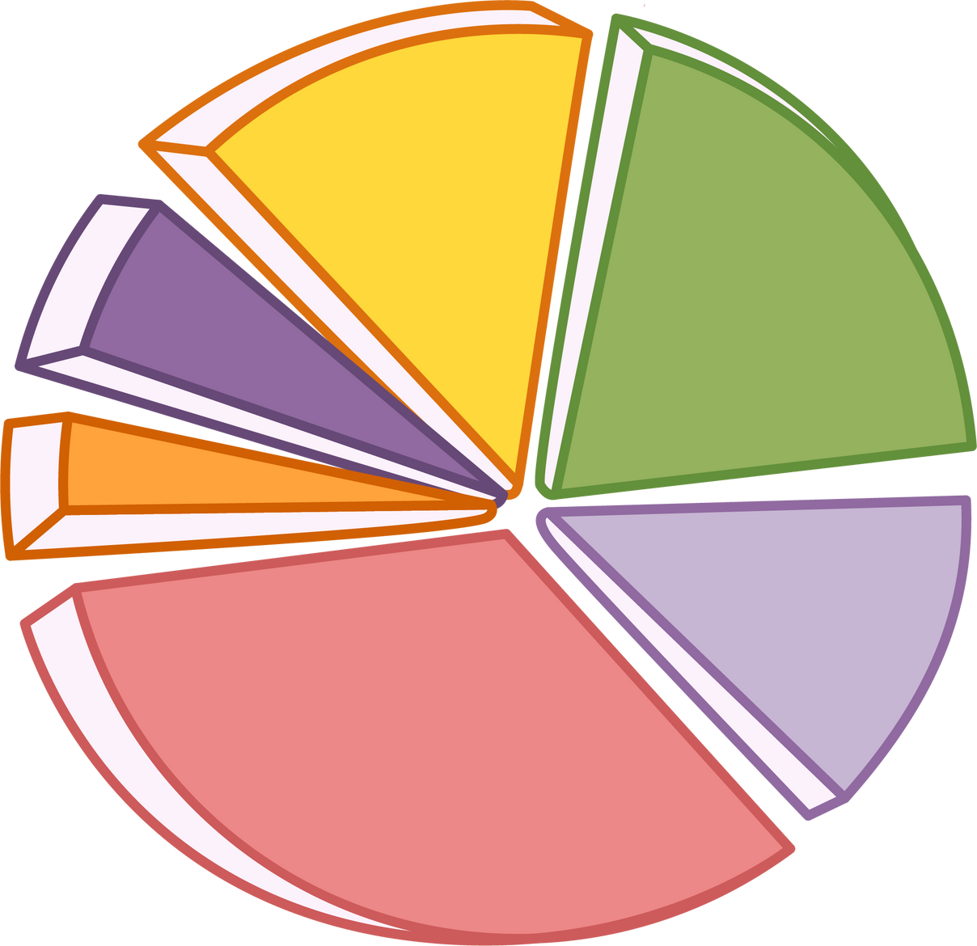
Project Overview & Objectives
To analyze sales data to identify trends, evaluate performance, and provide actionable business insights.
Goals:
  Analyze sales trends over time.
  Identify top-performing products and channels.
  Assess discount and profit relationships.
  Build an interactive sales dashboard with KPIs and automation.
02/10

Slide 3
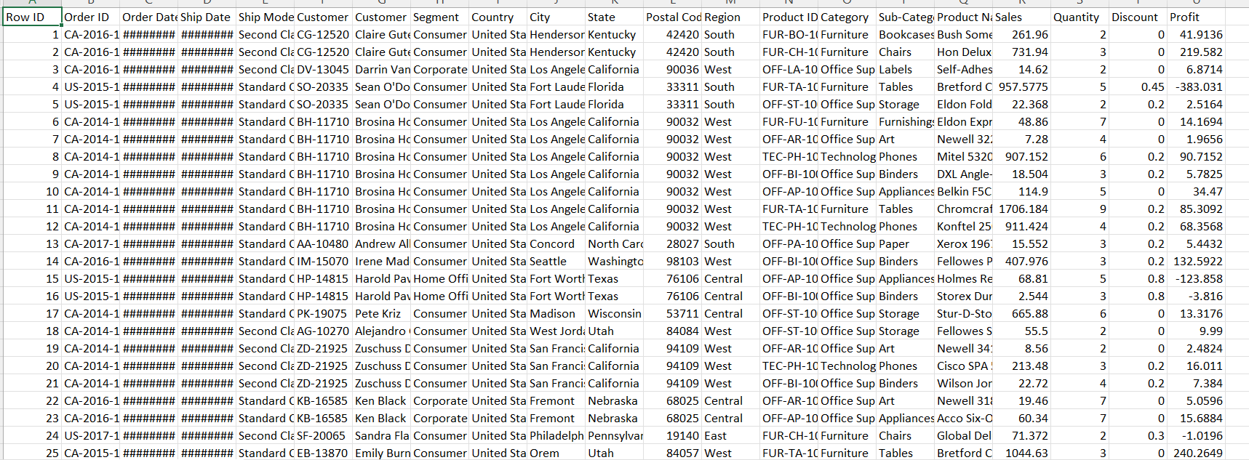
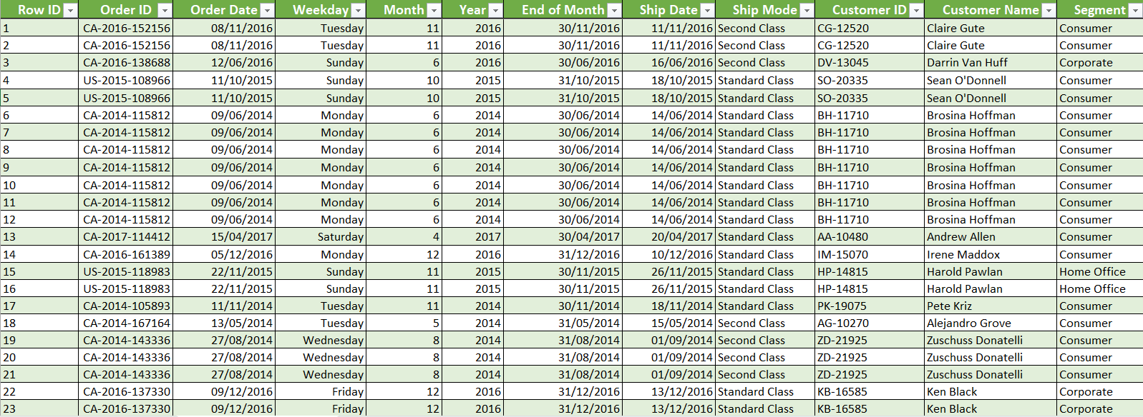
Dataset Before Data Cleaning Process:
Dataset Overview
The dataset used for this project is the Superstore sales dataset, consisting of approximately 9,995 rows and 13 columns. It contains detailed sales transaction information, including Order Date, Ship Date, Sales, Profit, Discount, Quantity, Product details, Region, and Category, providing a comprehensive view of the store’s sales performance.
Data Cleaning Process
  Imported the raw dataset using Get Data then From File (CSV/Excel) in Power Query.
  Removed blank rows and duplicate entries to ensure clean and accurate data.
  Set proper data types for each column, including dates for Order Date and Ship Date, and decimals for Sales, Profit, Discount, and Quantity.
  Renamed the query as Cleaned_Superstores_Sales_Dataset for better organization and tracking.
  Loaded the cleaned dataset into Excel as a formatted table for further analysis.
  Adjusted the column widths using the shortcut ALT + H + O + I to make all data clearly visible.
  Verified all records to confirm consistency and correctness before proceeding to analysis.
  Detected and highlighted potential outliers in sales and discount values using conditional formatting.
  Ensured all numerical fields were converted to Currency (AED) for standardization.
Dataset After Data Cleaning Process:
03/10

Slide 4


Metrics Calculated
  Adjusted Sales = Total Sales − Discount Amount
  Total Sales = Sales × Quantity
  Discount Amount = Total Sales × Discount Rate
  Total Revenue = Sum(Adjusted Sales Column)
  Average Order Value = AVERAGE(Adjusted Sales Column)
  Total Discount Amount = Sum(Discount Amount Column)
  Sales by Product Type: I used the UNIQUE function to list distinct categories and the COUNTIF function to count the total orders for each category.
UNIQUE function to list all the distinct product categories in Cell AF7
COUNTIF function to count the total number of orders for each category
04/10
Notes:
This part of the project was focused on calculating key numbers that describe overall sales performance. Metrics like total and average sales, profit margins, discount percentages, and return rates were calculated using Excel formulas. These figures helped build a clear picture of business performance and set the base for creating the dashboard and insights later in the project.

Slide 5
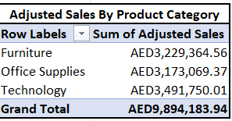
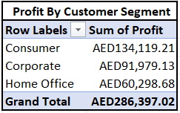
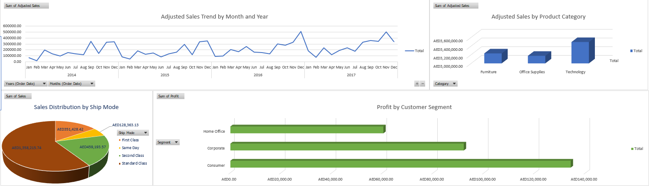
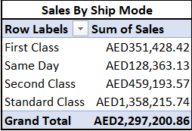
Pivot Tables and Pivot Charts
  Pivot Table Summary: Aggregated sales data by product category, sales channel, and customer segment, showing total and average adjusted sales and discounts.
  Time-Based Analysis: Grouped data by year, month, and quarter to identify seasonal trends and peak sales periods.
  Pivot Chart Visualizations: Used line, column, and pie charts to visualize trends, highlight high-performing products, effective shipping methods, and recurring patterns.
05/10
Notes:
I created PivotTables to summarize sales across different dimensions. For product categories, I calculated the total Adjusted Sales to see which products contributed most to revenue. For sales channels, I looked at the sum and average of Adjusted Sales and total discounts to identify the most effective shipping methods. I also analyzed customer segments to track profitability and sales performance.
For time-based analysis, I grouped the data by Year, Month, and Quarter using PivotTables. This helped to identify peak sales periods and seasonal trends. I then visualized these insights with Line and Column charts, which made it easier to spot high-performing months and recurring patterns across the years.

Slide 6
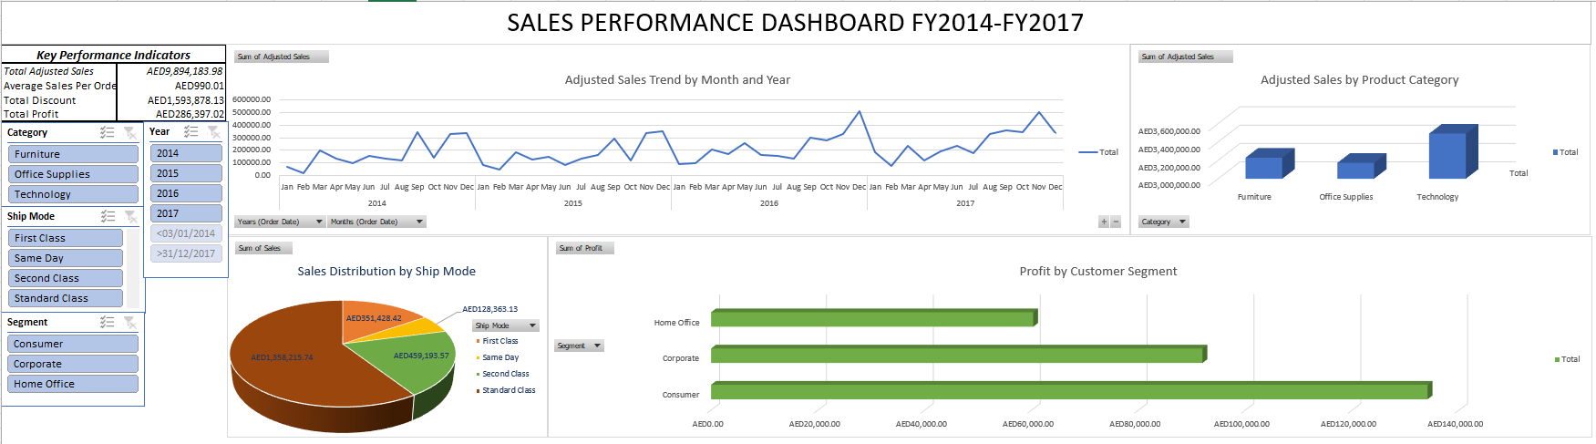
Dashboard Overview
  The Sales Dashboard provides a single interactive view that makes data easy to explore and analyze, combining KPIs, charts, and slicers to give a complete picture of sales performance.
  Key performance indicators at the top display total adjusted sales, average sales per order, total discounts, and total profit, allowing quick evaluation of overall business performance.
  Charts are used to visualize trends by product category, sales channel, customer segment, and time periods, while slicers let users filter dynamically by category, segment, ship mode, and year, helping identify high-performing products and monitor trends efficiently.
06/10
Notes:
The Sales Dashboard summarizes key insights in a single interactive view. Key Performance Indicator’s (KPIs) at the top show total adjusted sales, average sales per order, total discounts, and total profit. Charts in the middle visualize trends by product category, sales channel, customer segment, and time periods. Slicers on the side allow dynamic filtering by category, segment, ship mode, and year and are linked to all PivotTables so updates reflect instantly. Formatted KPI cards, resized charts, and a clean layout create a professional, easy-to-explore dashboard that helps identify high-performing products, monitor trends, and compare metrics efficiently.

Slide 7
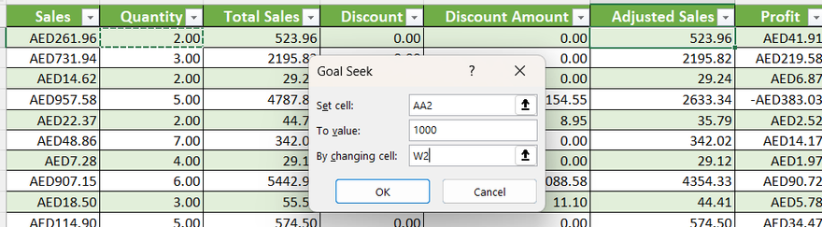
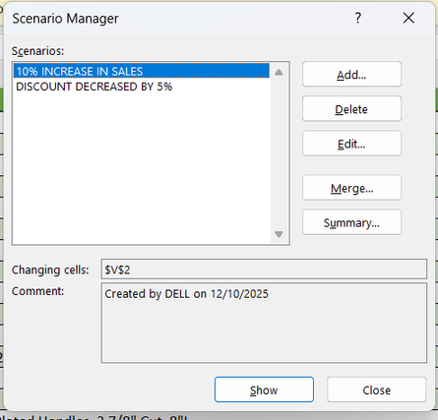
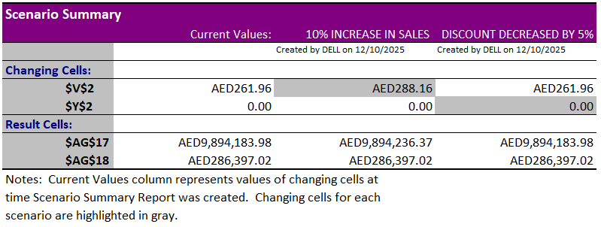
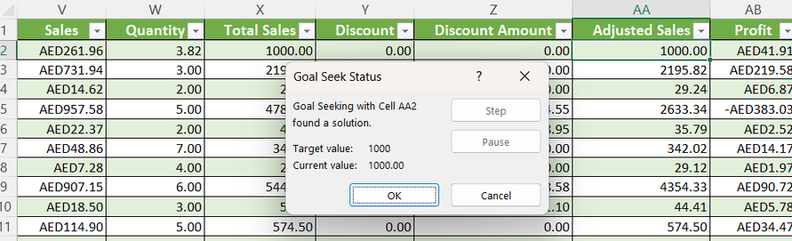
What-If Analysis & Goal Seek
  Used Goal Seek on a single transaction to find the quantity required to reach AED 1000 in Adjusted Sales.
  Reverted the transaction back to its original value of AED 523.96 to verify calculations.
  Applied Scenario Manager to test a 10% increase in sales and a 5% decrease in discounts.
  Set Total Adjusted Sales and Total Profit as result cells for scenario comparisons.
  Created a Scenario Summary showing the impact of each change on sales and profit, with supporting screenshots.
What-If Analysis Goal Seek Input:
What-If Analysis Goal Seek Output:
What-If Analysis Senario Manager
What-If Analysis Senario Summary
07/10
Notes:
Performed a Goal Seek test on a selected sales transaction to determine the quantity needed to reach a target Adjusted Sales value of AED 1000, by changing only the Quantity cell while keeping other factors constant.
Reversed the Goal Seek process to restore the original Adjusted Sales value of AED 523.96, ensuring accuracy and validation of the model’s calculations.
Used Scenario Manager to simulate the effect of increasing sales by 10% and reducing discounts by 5%, aiming to understand how such adjustments influence total Adjusted Sales and Profit.
Defined Result Cells for Total Adjusted Sales and Total Profit using SUM formulas, allowing Scenario Manager to calculate and display changes for each scenario.
Generated a Scenario Summary Report comparing the Current Case, +10% Sales, and −5% Discount scenarios, which clearly showed how performance metrics respond to pricing and sales changes, visualized through attached screenshots.

Slide 8
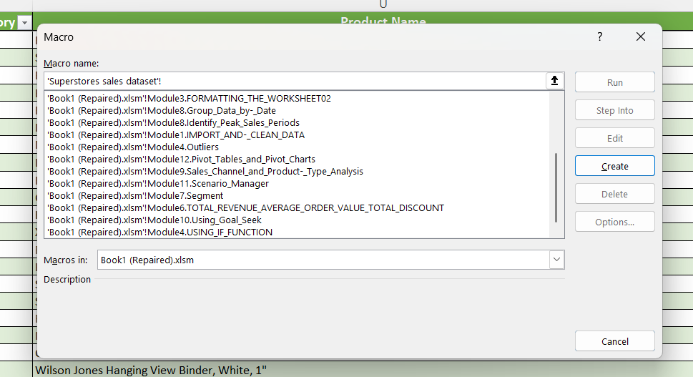
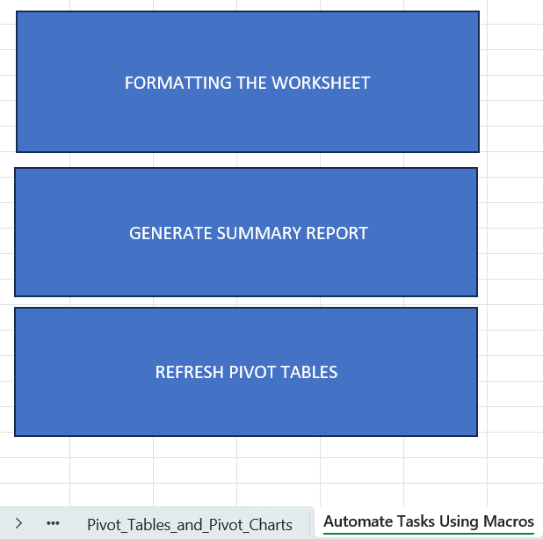
Macros and Automation
  Recorded a macro to format the worksheet consistently including currency, headers, and frozen top row.
  Created macros to generate PivotTables and PivotCharts for sales, category, and profit analysis.
  Built a macro to update Adjusted Sales calculations automatically when new data is added.
  Assigned all macros to dashboard buttons for one-click execution.
  Automation streamlined repetitive tasks, ensured consistency, and enabled fast updates across the report.
08/10
Notes:
Macros were used to automate repetitive tasks across the Excel project, saving time and ensuring consistency. I recorded macros to apply worksheet formatting, including currency styles, bold headers, and frozen top rows.
Macros were used to automate repetitive tasks across the Excel project, saving time and ensuring consistency. I recorded macros to apply worksheet formatting, including currency styles, bold headers, and frozen top rows. Additional macros generate summary PivotTables and PivotCharts for adjusted sales by category, sales by ship mode, and profit by segment. Another macro updates all calculations for Adjusted Sales when new data is added. Each macro was assigned to buttons on the dashboard, allowing one-click execution for formatting, reporting, and refreshing all visualizations, making the workflow faster and more efficient.

Slide 9
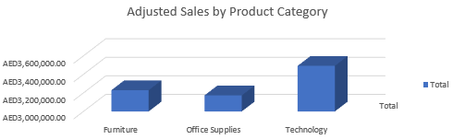
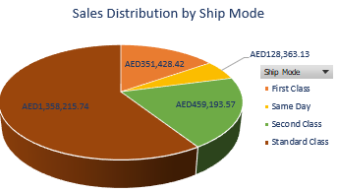
Insights and Recommendations
KEY INSIGHTS
  Standard Class is the top-performing sales channel with AED 1.36M, followed by Second Class (AED 459K), while Same Day contributes the least (AED 128K), showing customer preference for economical shipping.
  Chairs and Phones lead product category sales with AED 1.42M and AED 1.38M respectively, while Fasteners perform the worst at AED 15.5K, highlighting strong demand in Technology and Furniture.
  Standard Class generates the highest Adjusted Sales (AED 5.93M) but also the largest total discount (AED 970K), indicating discounts boost volume but reduce profitability.
Recommendations
  Optimize shipping by maintaining Standard Class reliability and cost-effectiveness and reviewing Same Day pricing to attract time-sensitive buyers.
  Boost high-performing product categories through promotions, and reconsider low performers like Fasteners with bundling, rebranding, or phase-out strategies.
  Refine discount strategies using targeted or tiered discounts for loyal or bulk customers while monitoring discount-to-profit ratios quarterly.
09/10

Slide 10

Conclusion
The project successfully analyzed sales data to provide actionable insights for the business, focusing on top-performing sales channels and products. Standard Class drives the most revenue while high-value categories like Chairs and Phones dominate adjusted sales, showing customer preferences.
Discounts improved sales volumes but impacted profitability, highlighting the need for targeted and strategic discount policies. Seasonal and time-based analysis identified peak sales periods, helping plan promotions and manage inventory effectively. Future steps include forecasting upcoming sales, optimizing discount strategies, and ensuring data accuracy for continued performance improvement.
10/10

